Slide 1
Room to Grow Enhancing Learning by Supporting Autonomy
Larry Rudiger
The University of Vermont
Stacie Spencer
MCPHS University
Keith Bujak
Georgia Institute of Technology
Best Practices Conference, 2013, Atlanta, GA

Slide 2
Letting go…
I like to be in control.
I strongly agree.
I mostly agree.
I mostly disagree.
I strongly disagree.
I'm in the wrong workshop.

Slide 3
The Plan
A bit of Self-Determination Theory (SDT)
J. Reeve's advice: how to enhance learning by supporting autonomy
Five mechanisms
A few case studies (about 3.5)
Think it through: where, how, and why might you provide more autonomy?

Slide 4
Self-Determination Theory
Preferences
Need for autonomy
Intrinsic motivation
Rich Ryan & Ed Deci

Slide 5
My teaching style
Usually mostly controlling.
Tends toward controlling.
Tends toward autonomy-supporting.
Usually mostly autonomy-supporting.
Depends on the course.

Slide 6
Autonomy Support: Why?
Better student outcomes: learning, subsequent motivation, engagement, performance, and well-being
Benefits for teachers: more accomplishment, less emotional exhaustion; greater relationship satisfaction.
Learn-able: novice & experienced teachers respond to training
See Reeve, 2011, for details.

Slide 7
Autonomy Support: How?
Recognize your students' experiences.
Bring that into the learning process.
Develop student's capacity for autonomous self-regulation.
And now, five mechanisms.

Slide 8
1. Nurture inner motivational resources.
Use when introducing a new learning activity, to spur engagement.
Autonomy-Supportive | Controlling
Inner motivational resources: | External motivational resources:
Need for autonomy | Directives, commands
Intrinsic motivation | Compliance requests
Self-endorsed goals & values | Assignments
Optimal-challenge preference | Incentives
Curiosity | Rewards
Students as origins, agents, doing what they value.
Adapted from Reeve, 2011

Slide 9
MRI?
Had one, no biggie.
Had one, a bit of nerves.
Had one, a LOT of nerves.
Never had one.
What's an MRI?

Slide 10
Case Study Stacie & the MRI Project
Health Psychology students work with MRI students to address the issue of MRI-related anxiety
Consultation model
Interprofessional education (IPE) opportunity
Development of Institute of Medicine (IOM) Core Competencies
Development of professional identity

Slide 11
1. The MRI Project
Used to spur engagement.
Autonomy-Supportive | Controlling
Inner motivational resources: | External motivational resources:
Provide personal experience | Describe typical experience
Student-selected evidence | Professor-assigned readings
Identification of issues to address | Assigned issues to address
Student-determined solutions | Professor-determined solutions
Students as origins, agents, doing what they value.

Slide 12
2. Provide explanatory rationales.
Use when the task is uninteresting (but important).
Autonomy-Supportive | Controlling
Communicate and reveal the task's… | Offer no rationale, and students come to think that…
importance | it's busy work
potential usefulness & significance | rules are arbitrary
value, especially when not obvious | they are being ordered around
Students internalize value (from not worth to worth doing).
Adapted from Reeve, 2011

Slide 13
Case Study Stacie & RM Consulting
Real-world questions
Students collaborate to
Review the literature
Design a study
Prepare a recommendation
Increased engagement

Slide 14
2. RM Consulting.
Use when the task is uninteresting (but important).
Autonomy-Supportive | Controlling
Communicate and reveal the task's… | Offer no rationale, and students come to think that…
similarity to real-world decision making | they won’t have to do these things after college
relevance to other courses | this is just what this professor wants
contribution to developing skills expected by employers | silly professor, research methods is just a required course
Students internalize value (from not worth to worth doing).

Slide 15
3. Employ non-controlling, informational language.
Use when communicating requirements & responsibilities; when giving feedback; or addressing unproductive behavior.
Autonomy-Supportive | Controlling
Communicate requirements & address problems with messages that are…
nonevaluative | evaluative
flexible | rigid
informational | high-pressure
Maintains positive student-teacher relationships
Helps students self-diagnose (and take responsibility for) performance.
Adapted from Reeve, 2011

Slide 16
Case Study Keith and a MOOC
Learning environments
Coursera: video lectures, assignments, quizzes
Dr. Anderson Smith, Alex Duncan
Open Learning Initiative (OLI): text, videos, activities
Carnegie Mellon University
Of 27,000 enrolled students…
63% were “active”
56% watched first lecture
41% accessed online tools (OLI)
7% watched final lecture
4% took the final exam
Notes:
This page sets the stage for what we did, gets audience members thinking about the variety of students in the course… for example, if only 4% took the final exam, where were the goals and needs of the other students? Perhaps supporting autonomy for some students will look different than other students. We need to know who they are and, more importantly, why they are participating.

Slide 17
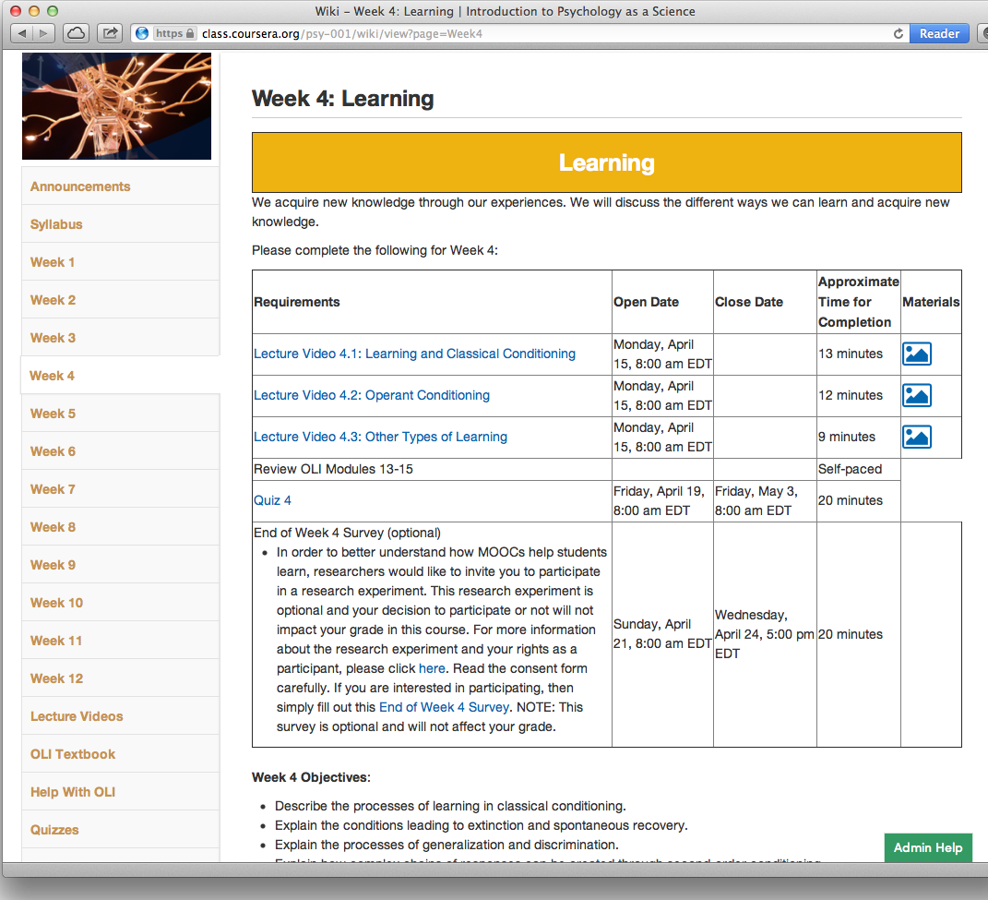

Slide 18
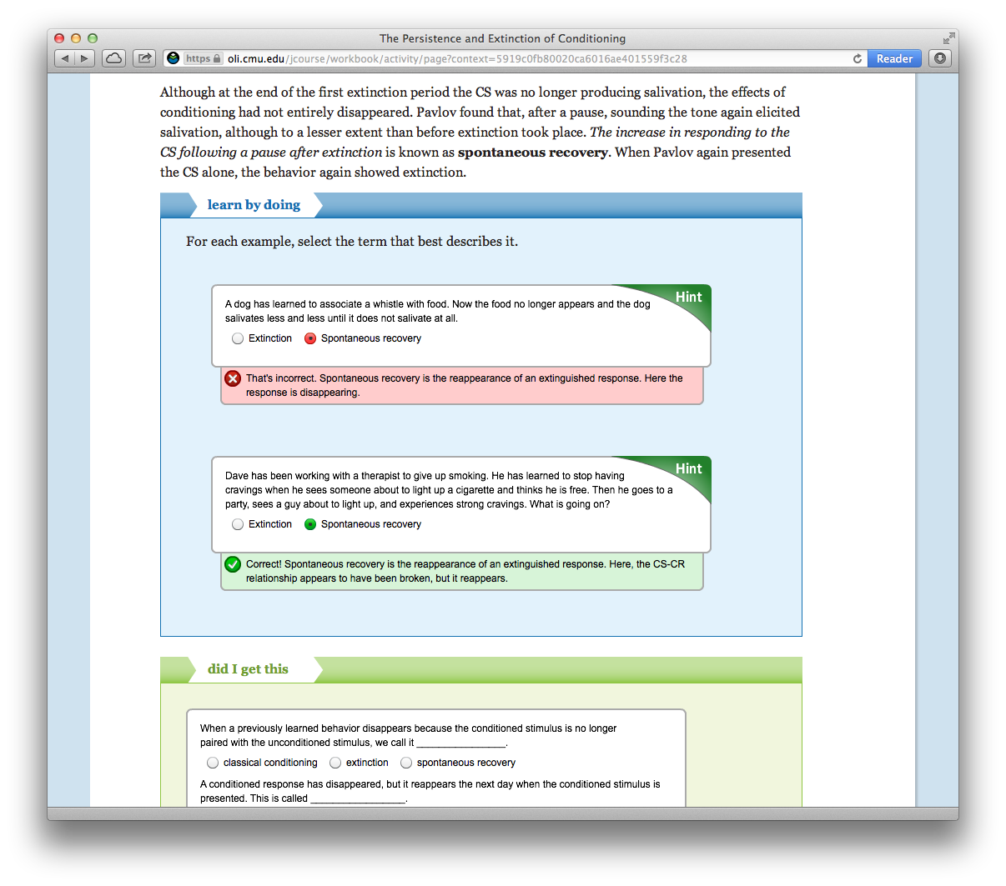

Slide 19
Case Study Keith and a MOOC
OLI
Optional, yet 41% of students accessed it
The OLI textbook is a great tool. I've already done some courses on Coursera, but this is the first time I encounter[ed] such a textbook. I really appreciate that and would like to see it for more courses!
Written assignments
Rubric was brief and general
Some students were frustrated
Quizzes
Allowed one week to complete, then two weeks
Some students wanted more time
Notes:
Three quick illustrations:
OLI was completely optional, no grades for it, no way of knowing who read and who didn’t, yet 41% accessed it at least once, quite pleased and surprised by how appreciative students were
Although the course was “self-paced”, they needed to complete weekly quizzes one week after the lectures were available, wanted more time, gave them more time (2 weeks), then students wanted even more time… could not accommodate because instructor felt like there would be no way students could cram all the material and quizzes in at the end of the course
Instructor wanted the rubrics for the two written assignments to be vague… he did not want to tell them exactly what to write and how to write it… in a quality review of the course, the reviewers also had concern about this, but the instructor stood by his decision…. Wanted to encourage creativity in the written assignments by not telling them exactly what to do.

Slide 20
4. Be patient. Make learning the constant, time the variable.
Use when learning complex concepts or skills that require trial-and-error, reflection, and revision.
Autonomy-Supportive | Controlling
Displaying patience as students… | Impatiently interrupt and…
explore & manipulate materials | offer a (your) solution
make plans & set goals | do it for them
revise work & work strategies | invade their space
Learning takes time (more than most predict).
Adapted from Reeve, 2011

Slide 21
Case Study Larry & U-Pace
Mastery-based, self-paced.
Higher grades, and more learning, especially for disadvantaged students.
Students who are ADA (Americans with Disabilities Act) eligible
Attempting to coach learning skills and content mastery under deadlines.
Anxiety, depression, other episodic conditions

Slide 22
5. Acknowledge & accept resistance & negative emotion.
Use when learning complex concepts or skills, AND when student preferences don't match teacher requests & requirements.
Autonomy-Supportive | Controlling
Respond to resistance & negative emotion with… | Counter/control resistance & negative emotion…
acceptance | dismissively
acknowledgement | with counter-arguments
gratitude | to (immediately) change behavior
…because they are potentially valid. | …so that it's acceptable to you.
Students often have a point. Focus on coaching impression management.
Adapted from Reeve, 2011

Slide 23
Small Case Study
Impression Management Dr. Rudiger's Finishing School

Slide 24
Reflection
List up to 3 current practices where you could offer more autonomy support.
Rate each on the dimension given on your worksheet.

Slide 25
Discussion
How could you increase autonomy support in a course you will teach next semester?
Which mechanisms will you use?
What are the barriers or your concerns?
Alternate so all have a turn!

Slide 26
Autonomy-Supportive Mechanisms
Mechanism | Needed the most when…
1. Nurture internal motivational resources | a new activity; seeking student initiative & initial task engagement.
2. Provide explanatory rationales | an uninteresting (but important) task that is rule-bound, procedural.
3. Provide noncontrolling, informational language. | conveying requirements, responsibilities, feedback, or addressing motivational or behavioral problems.
4. Be patient | the task is complex, iterative.
5. Acknowledge & accept resistance and negative emotion. | developing skills, just getting going, or when student and teacher goals are not aligned.
Adapted from Reeve, 2011

Slide 27
Which mechanism?
Click on the one that you think is most important to your planned revision.
Nurture inner motivational resources
Provide explanatory rationales
Use noncontrolling, informational language
Be patient.
Acknowledge & accept resistance and negative emotion.

Slide 28
Duct-tape parenting teaching

Slide 29
Thank you!
Keith: Bill and Melinda Gates Foundation, The William and Flora Hewlett Foundation, Lumina Foundation, & The Walter S. Johnson Foundation.
Larry: Keith & Stacey
Stacie, Keith, & Larry: all y'all!

